Slide 1
Glance
Visualising Reddit with Topics Over Time
Team 21: Mehmet Suat Gunerli, Asha Gutlapalli, Dipendra Singh Mal, Yashwant Singh, Anshit Verma, Jaylen Williams

Slide 2
Motivation
It is hard to keep up with all the various news pouring in all domains like technology, Politics, Health, Sports, etc. Even harder to get valuable insights from it.
The significance of these topics may also change as time passes in years or even months.
Our motive is to detect and keep track of the emerging topics and make relevant information from Reddit easily consumable for different organisations to plan ahead and make data-informed decisions.
Topic modeling is functional for comprehensive quantification and practical representation of the data [5][3] and must evolve to adapt for different document lengths [2] like the various text sizes in Reddit.
Notes:
Answer for HQ1: What are you trying to do? Articulate your objectives using absolutely no jargon.

Slide 3
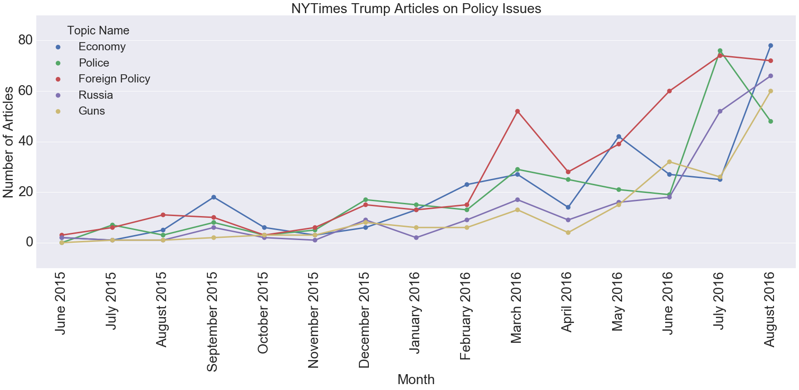
Project Overview
Current implementations of topic modeling that do factor in time only keep track of popularity of the trend at that time period.
Our project aims to model topic for a time period and keep track of how the topic has evolved over the time.
It can keep track of trends and semantic changes in the topic.
Fig 1. Current Topic Modeling Over Time
Notes:
_________________
Answer for HQ2: How is it done today; what are the limits of current practice?
Answer for HQ3: What's new in your approach? - Our project aims to model topic for a time period, adding a new aspect in our approach that keeps track of how the topic has evolved over the time
HQ3: Why will it be successful?-
Expected innovations

Slide 4
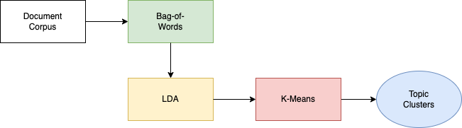
Our Approach
K-means groups similar visual and textual documents adding dimensionality to the model to help improve its decisions [4].
Other algorithms were considered, but had greater limitations:
Newman - not deterministic and can lead to different groups per run [6]
Excess Correlation Analysis - unstable and needs randomization to compute SVD [1]
Notes:
Note: describe graphic and then go into bullets
From clustering and other methods section in report:
First bullet: 9th lit review
Second bullet: 17th, and 1st lit review

Slide 5
Who Cares?
Impact:
Measures of Success:
Businesses looking to keep financial/marketing tactics relevant with current topic trends
Providing valuable insight into current and changing topics for the current market
User feedback, Observations, Model perplexity scores
Notes:
Answer for HQ4: Who cares?
Answer for HQ5: If you're successful, what difference and impact will it make, and how do you measure them (e.g., via user studies, experiments, ground truth data, etc.)?

Slide 6



Costs
Risks
Payoffs
Unstructured data requires a lot of processing
The possibility for large storage/computing requirements
Discovery of hidden trends on a large data source
A potential future resource for recommendation and classification tasks
Notes:
Answer for HQ6, 7: What are the risks and payoffs?, How much will it cost?
If decision to use a paid cloud computing service: $

Slide 7
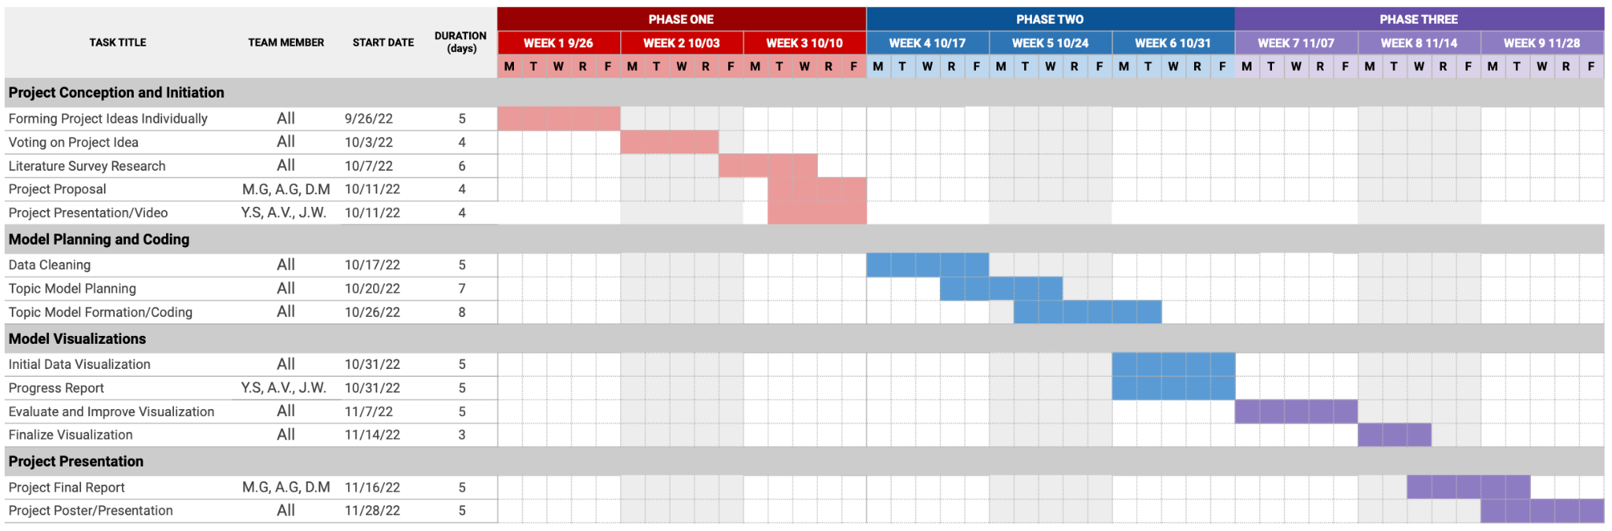
Plan of Tasks
For the proposal tasks, all members contributed to the literature survey while Mehmet, Asha, and Dipendra worked on the proposal, Anshit and Jaylen worked on the presentation slides and Yashwant is presenting the video. All other tasks will be evenly distributed between all group members who will each give an equal amount of effort.
Notes:
Answer for HQ8: How long will it take? 6 weeks
Answer for HQ9: What are the midterm and final "exams" to check for success? How will progress be measured?

Slide 8
Literature Survey References
[1] Animashree Anandkumar, Dean P. Foster, Daniel J. Hsu, Sham M. Kakade, and Yi-Kai Liu. Two svds suffice: Spectral decompositions for probabilistic topic modeling and latent dirichlet allocation.CoRR ,abs/1204.6703, 2012.
[2] Stephan A. Curiskis, Barry Drake, Thomas R. Osborn, and Paul J. Kennedy. An evaluation of document clustering and topic modelling in two online social networks: Twitter and reddit. Information Processing Management, 57(2):102034, 2020.
[3] Liangjie Hong and Brian D. Davison. Empirical study of topic modeling in twitter. In Proceedings of the First Workshop on Social Media Analytics, SOMA ’10, page 80–88, New York, NY, USA, 2010. Association for Computing Machinery.
[4] Yunhwan Kim and Sunmi Lee. #shoutyourabortion on instagram: Exploring the visual representation of hashtag movement and the public’s responses. SAGE Open, 12(2):21582440221093327, 2022.
[5] David Mohaisen. Computational data and Social Networks: 10th International Conference, csonet 2021, virtual event, November 15-17,2021: Proceedings. Springer, 2021
[6] Anke Wonneberger, Iina R. Hellsten, and Sandra H. J. Jacobs. Hashtag activism and the configuration of counterpublics: Dutch animal welfare debates on twitter. Information, Communication & Society ,24(12):1694–1711, 2021.

